Slide 2
Wealth-Building through the F&I Department
Kirk Borchardt
Executive Vice President

Slide 3

Introduction
Opening comments
Multiple structures – not just reinsurance
May seem like everything is cutting-edge new
“The more things change, the more they stay the same.”

Slide 4
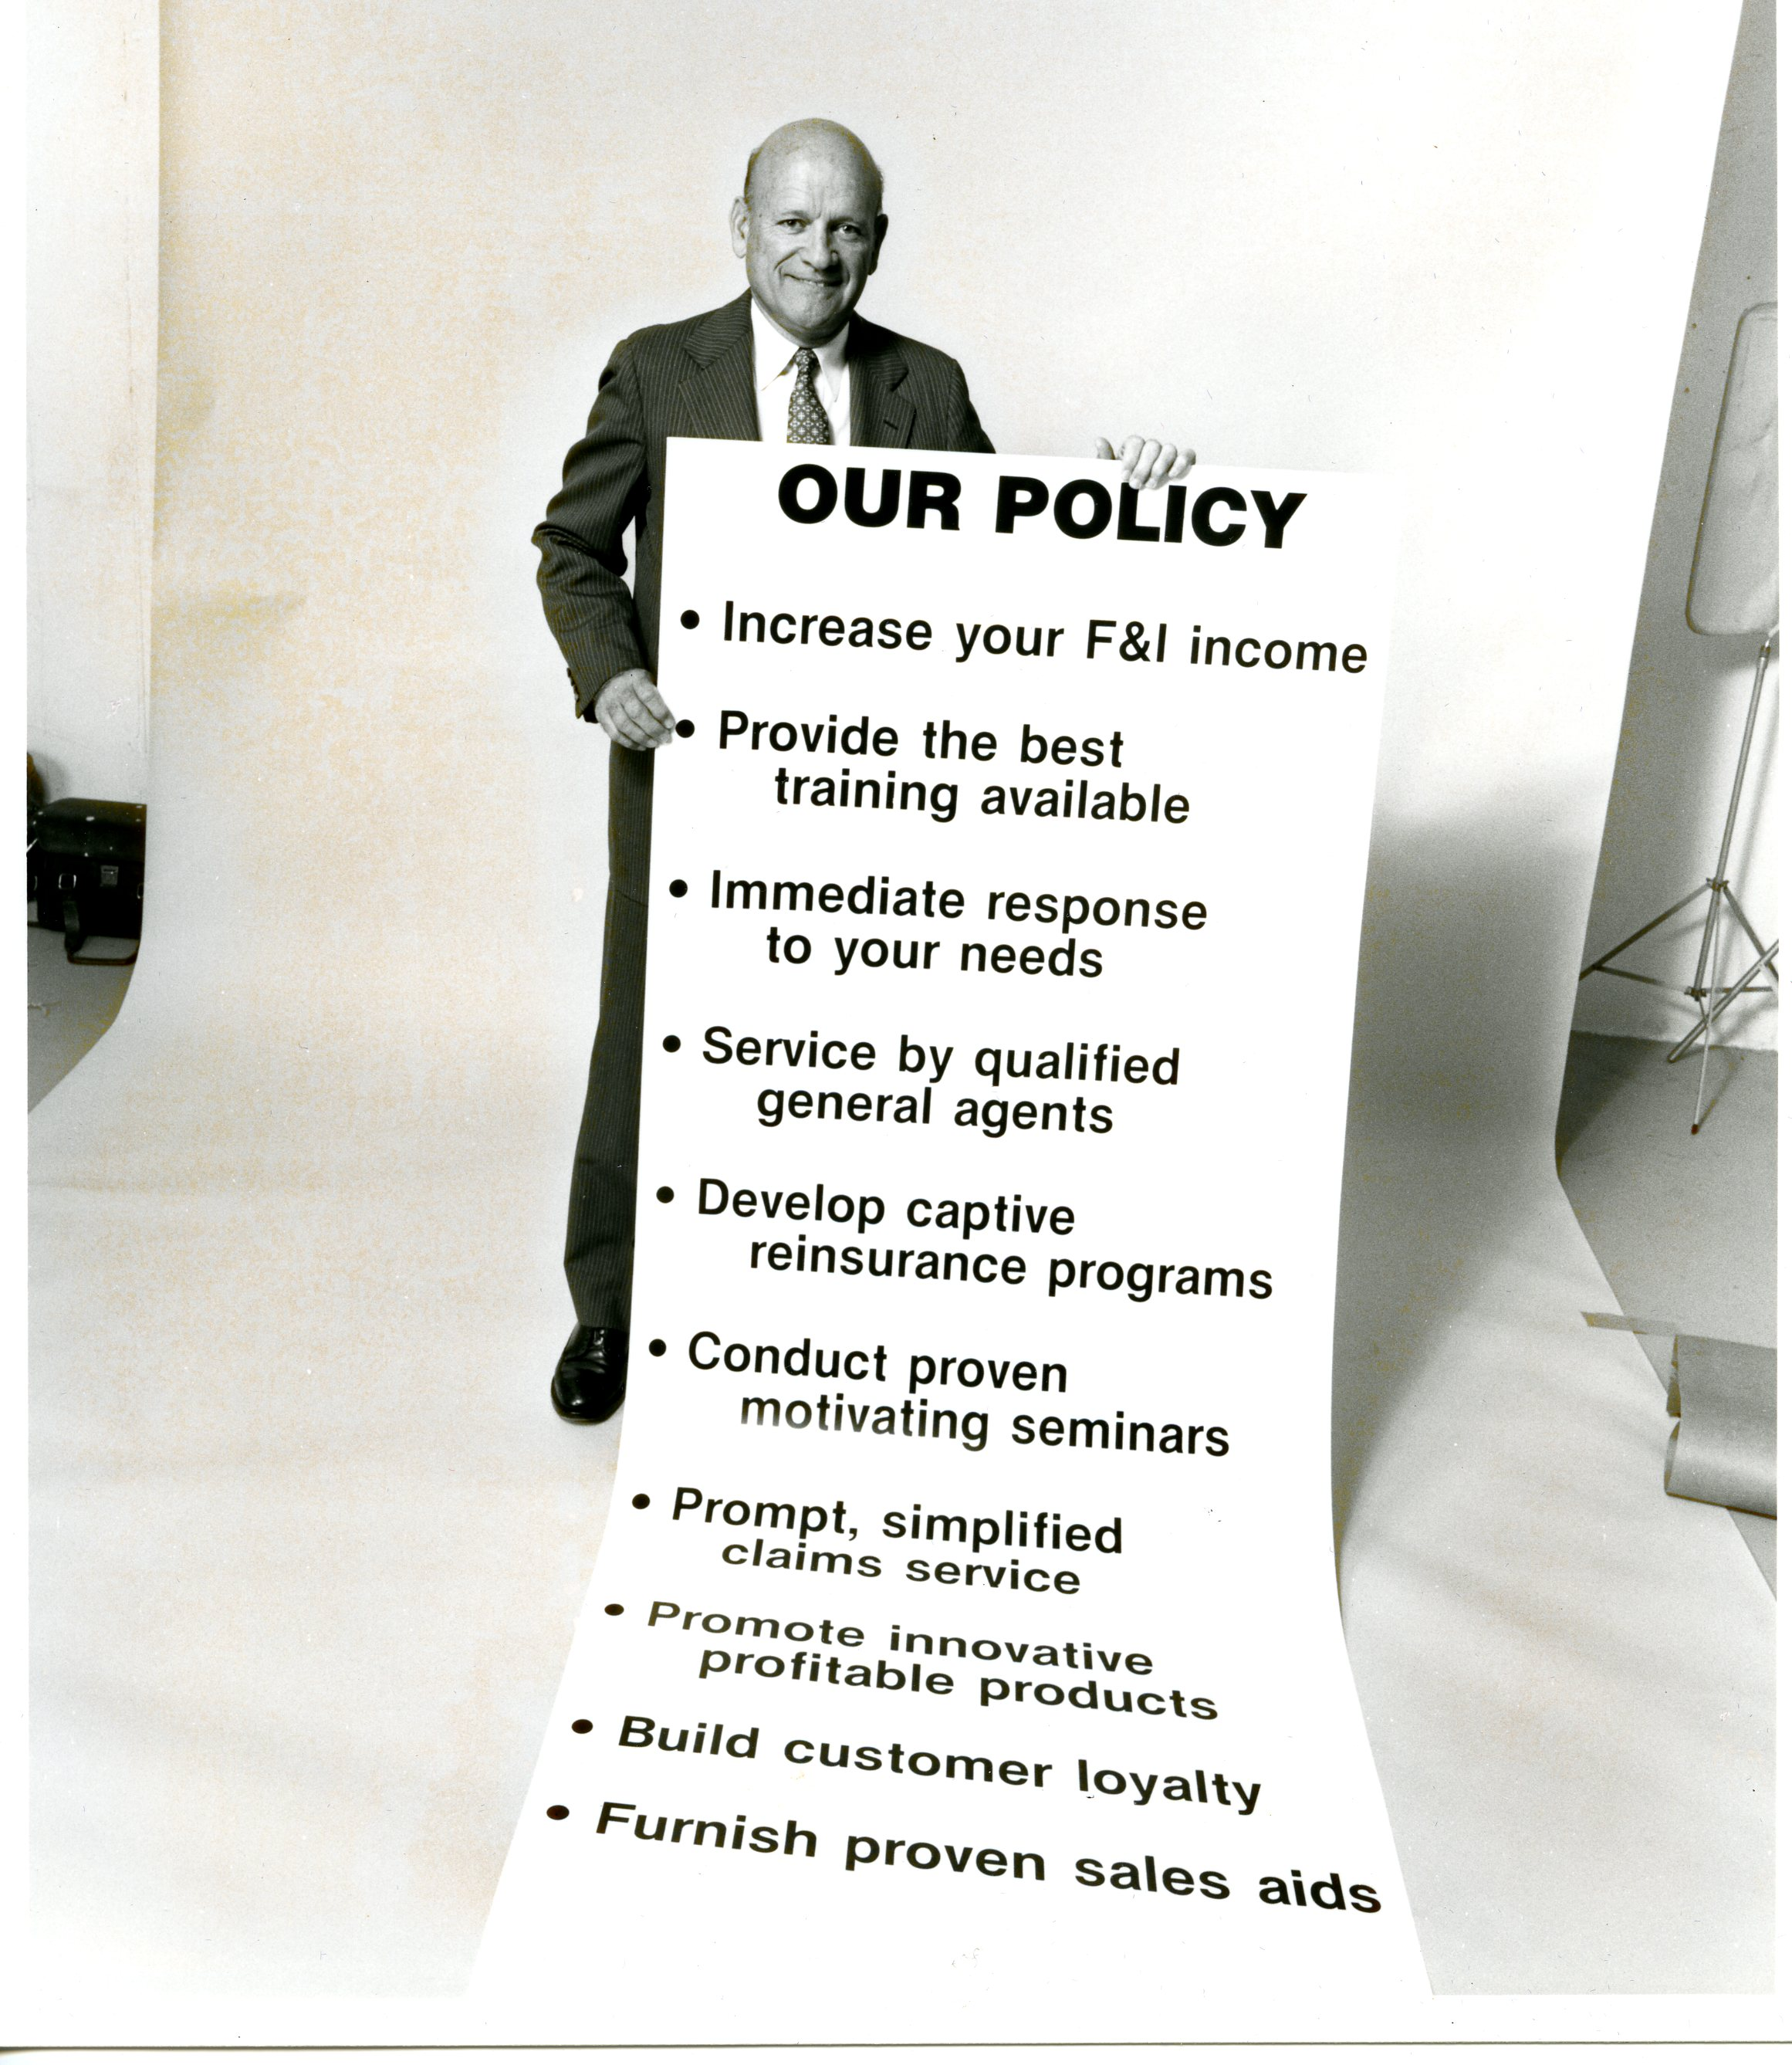
[c. 1975]

Slide 5
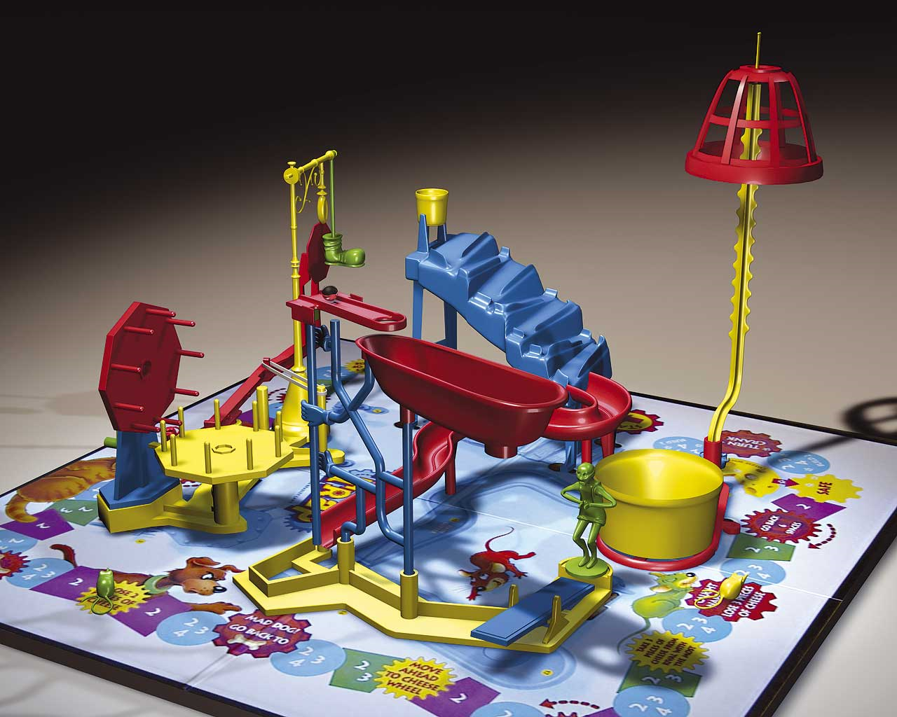
Profit Options
Primary considerations:
Financial returns: It’s not the mousetrap – it’s the cheese
Reserve level
Maximize investment core
Access to funds

Slide 6

Profit Options
Dealer obligor/first extended
Profit share
Reinsurance/CFC
Dealer Owned Warranty Corporation (DOWC)
Reinsurance/NCFC

Slide 7
Assumptions
Five years of production ($2,040,000 per year)
100/mo. new VSC and 100/mo. used VSC
Reserves: $900 new and $800 used
Durations: 5-year new and 3-year used
Loss ratio: 65%
Total premiums: $10,200,000
Total claims: $6,630,000
Underwriting profit: $3,570,000

Slide 8
It’s All in the Taxes
What is taxed? Less is better than more
When is it taxed? Later is better than earlier
At what rate is it taxed? Capital gains rate versus ordinary income rate

Slide 9
Dealer Obligor
Structure: DO contracts; failure to pay (FTP) CLIP; dealer holds all the reserves
Taxation:
Dealer taxed on full reserve $$ (most)
Tax paid in the year of receipt (earliest)
Ordinary income tax rate (highest) (40%)
Taxes Paid:
Year 1 | Year 2 | Year 3 | Year 4 | Year 5 | Year 6 | Year 7 | Year 8 | Year 9 | Year 10 | Total
768,191 | 662,895 | 535,503 | 431,083 | 342,700 | -482,591 | -377,295 | -249,903 | -145,483 | -57,100 | 1,428,000

Slide 10
Profit Share/Retro
Structure: AO contracts; profit share paid each year based on earned premium less claims
Taxation:
Dealer taxed on profit share payments
Tax paid in the year of receipt
Ordinary income tax rate
Taxes Paid:
Year 1 | Year 2 | Year 3 | Year 4 | Year 5 | Year 6 | Year 7 | Year 8 | Year 9 | Year 10 | Total
25,744 | 82,441 | 151,037 | 207,263 | 254,854 | 259,856 | 203,159 | 134,563 | 78,337 | 30,746 | 1,428,000

Slide 11
Reinsurance/CFC
Structure: AO contracts; dealer participates through a company (RIC) taxed under IRC §831(b)
Taxation:
RIC tax on investment income; dealer taxed on dividends or liquidating distribution
RIC taxed each year; dealer taxed on the year of receipt of the dividends/distribution
RIC taxed at corporate rates (21%); dealer taxed at capital gains rate (20%)

Slide 12

Reinsurance/CFC
Taxes Paid by RIC:
Year 1 | Year 2 | Year 3 | Year 4 | Year 5 | Year 6 | Year 7 | Year 8 | Year 9 | Year 10 | Total
6,070 | 17,462 | 27,291 | 35,527 | 42,441 | 42,323 | 36,532 | 32,437 | 30,070 | 29,165 | 299,318
By shareholder: Depends on distributions, but will be at 20%

Slide 13
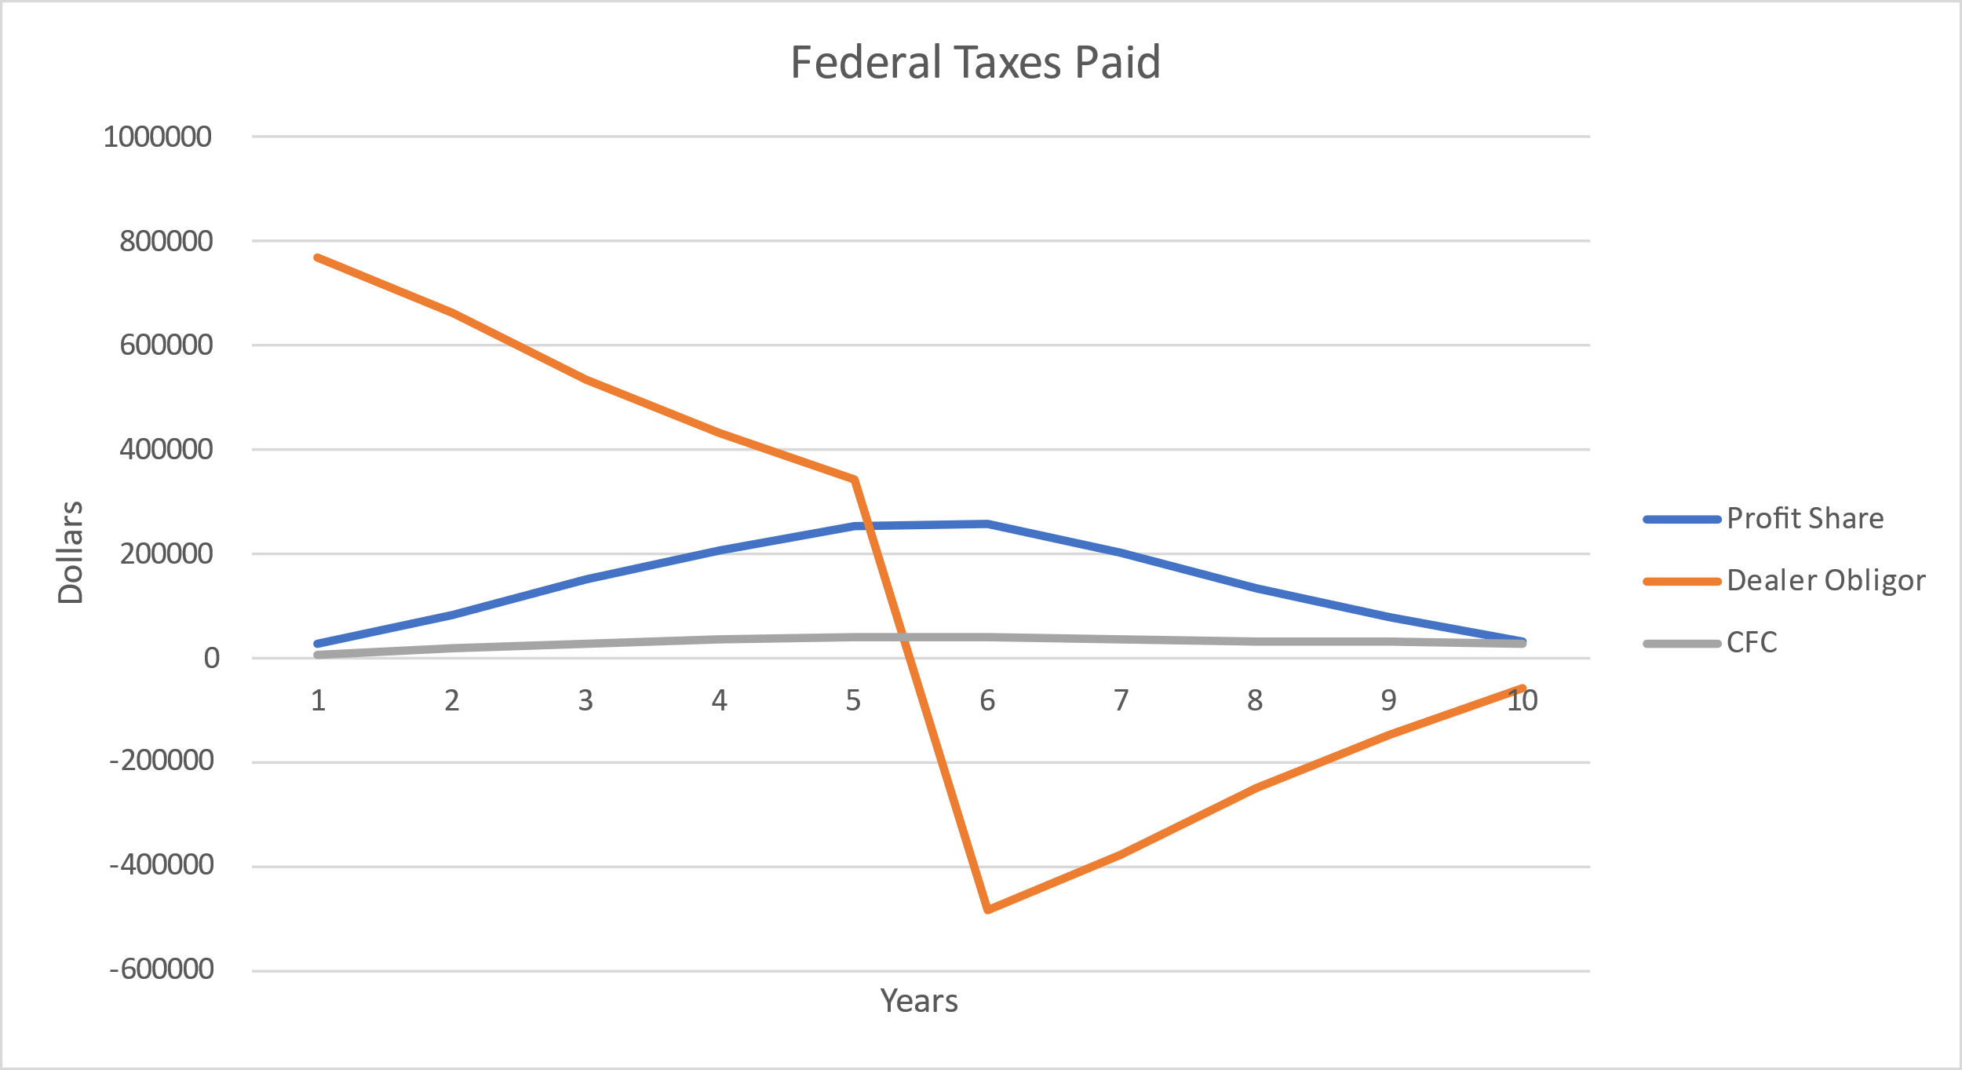
Tax Comparison
 | Year 1 | Year 2 | Year 3 | Year 4 | Year 5 | Year 6 | Year 7 | Year 8 | Year 9 | Year 10 | Total
DO | 768,191 | 662,895 | 535,503 | 431,083 | 342,700 | -482,591 | -377,295 | -249,903 | -145,483 | -57,100 | 1,428,000
P/S | 25,744 | 82,441 | 151,037 | 207,263 | 254,854 | 259,856 | 203,159 | 134,563 | 78,337 | 30,746 | 1,428,000
CFC | 6,070 | 17,462 | 27,291 | 35,527 | 42,441 | 42,323 | 36,532 | 32,437 | 30,070 | 29,165 | 299,318

Slide 14
DOWC
Structure: Dealer forms his or her own warranty obligor
Taxation:
DOWC is taxed like an insurance company
Due to large net operating losses (NOLs), no taxes paid by the DOWC for 10-12 years
DOWC elects 831(b) treatment when NOLs run dry; avoids corporate tax on the U/G
Dividends taxed at capital gains rate
Liquidating distribution taxed at the capital gains rate

Slide 15
NCFC
Structure: Off-shore multi-shareholder company where no shareholder owns 10% or more by vote or value; maintains no U.S. business contacts
Taxation:
The company not subject to U.S. tax
Shareholder taxed on dividends at ordinary income rate
Liquidating distribution paid to the shareholder at the capital gains rate (except for RPPI)

Slide 16
Access to Funds: FIP
Flexible Investment Plan
We release a portion of UPR in excess of amount necessary to pay 110% of future benefits (FB)
40% minimum
If trust balance becomes deficient (less than 110% of FB), we suspend releases as necessary
Option to call releases if dealer stops producing

Slide 17
Access to Funds: FIP
Signing up for FIP:
Three documents to execute:
FIP addendum to reinsurance agreement;
Demand promissory note to return funds; and
Principal owner guaranty
One-year waiting period, which can be waived for existing dealers

Slide 18
Access to Funds: FIP
Sample FIP Calculation:
$2,040,000 annual premium; 65% loss ratio

Slide 19
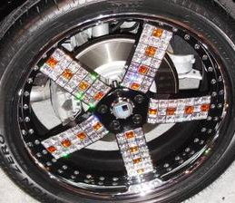


Access to Funds: FIP
Expansion of FIP:
Will be adding other products
Still evaluating which products make sense; need credible and reliable data
Some products will not be included

Slide 20

Expanding to Include Florida

Slide 21

Access to Funds: FIP
Available to legacy Southwest Reinsure dealers

Slide 22
Q&A
Thank You

